Slide 1
Leaf Classification
By Ethan Scott

Slide 2
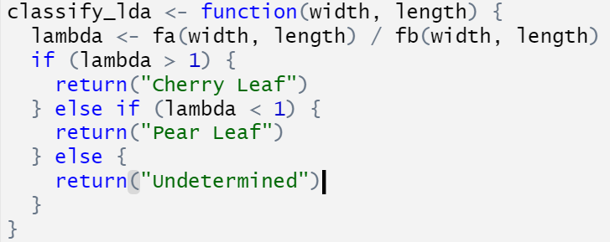
LDA
Pooled Covariance Matrix
Fa = bivariate normal for Cherry leaves
Fb = bivariate normal for Pear leaves
y=-13.7932 + 2.303389x

Slide 3
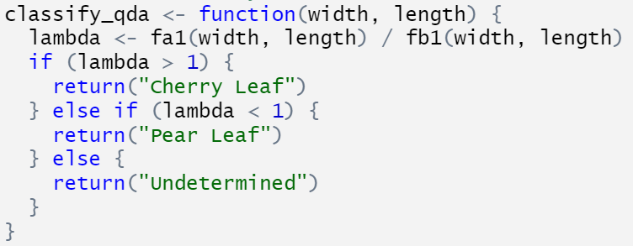
QDA
Covariance Matrices are different
Fa1 = bivariate normal for Cherry leaves
Fb1 = bivariate normal for Pear leaves

Slide 4
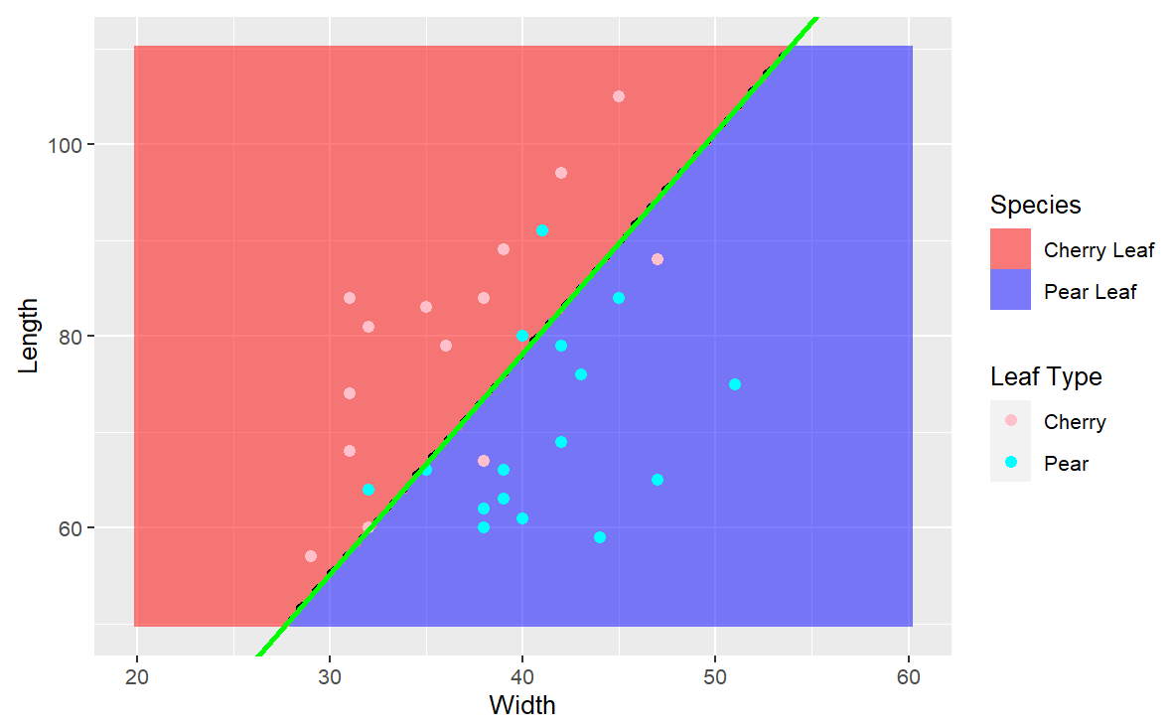
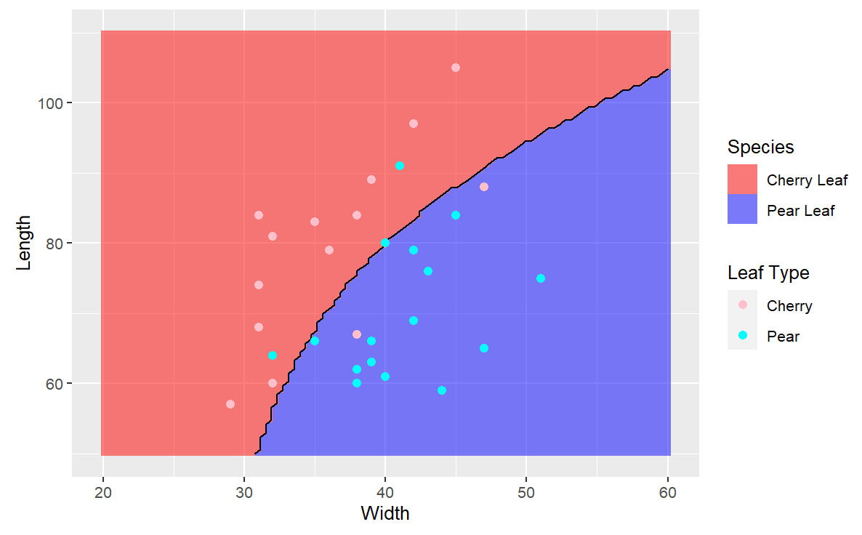
Graphical Comparison
LDA QDA

Slide 5
Classification of New Leaves
LDA
QDA
Leaf # | Width(mm) | Length(mm) | LDA Classification
1 | 32 | 82 | Cherry Leaf
2 | 38 | 52 | Pear Leaf
3 | 40 | 76 | Pear Leaf
Leaf # | Width(mm) | Length(mm) | QDA Classification
1 | 32 | 82 | Cherry Leaf
2 | 38 | 52 | Pear Leaf
3 | 40 | 76 | Pear Leaf

